Slide 1

Predicting Employee Attrition
24 Mar 2021
Notes:
Intro team members
For this project we are assuming the role of a consultancy firm providing services to our client called SingVac

Slide 2
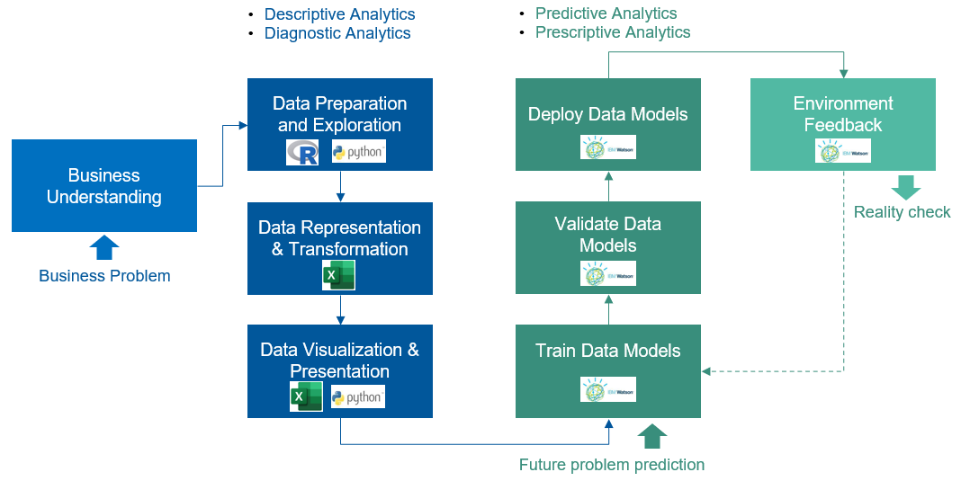
Data Science Methodology and Process
Notes:
Overview of the data science and methodology and process that we will be following; 8 steps
Highlight tools used

Slide 3
1. Business Understanding

Slide 4
Business problem and project objectives
Background
Business problem
Project objectives
SingVac wants to better position itself to increase market share
SingVac has a relatively high attrition rate recognizes that it needs to better retain its talents to achieve its goals
How might we help SingVac to better retain talent so that the company can maximize productivity and reduce turnover costs?
Understand the state of employee attrition in SingVac
Identify factors that predict employee attrition
Enable targeted interventions using data-driven insights
Notes:
• Client: SingVac, a pharmaceutical company
• The COVID-19 pandemic has presented huge business opportunities for SingVac, they are seeking to better position themselves for further growth and increase their market share
• But to do this, they recognize that they need to sort out some internal issues – even as they intensify their hiring efforts, they know that they also need to look into how to better retain their existing talents
• Because attrition is very costly - it leads to reduced productivity (vacancies, time to productivity) as well as additional costs (e.g. recruitment costs, training costs)
That’s why they engaged us to help them with this issue.

Slide 5








Common factors related to employee attrition
Non-competitive compensation/benefits
Poor work-life balance
Lack of career progression opportunities
Lack of growth or training opportunities
Poor employee-manager relationship
Weak organizational leadership/management
Low job satisfaction or job involvement
Unpleasant or unproductive working environment
Notes:
To understand this business problem a bit better, we conducted research on what are some of the common factors or latest trends related to employee attrition across companies
We also had a meeting with SingVac HR to better understand what they think could be possible factors for SingVac, as well as what kind of employee data they currently have

Slide 6
Data requested from SingVac
Employee data from 1 Jan - 31 Dec 2020 comprising of:
• Standard HR employee data
• Data from employee surveys
Notes:
The knowledge helped to inform what data we will request from SingVac
Standard HR employee data - e.g job level, monthly income
Employee surveys - e.g. relationship satisfaction with manager, job satisfaction

Slide 7
2. Data Exploration and Preparation

Slide 8

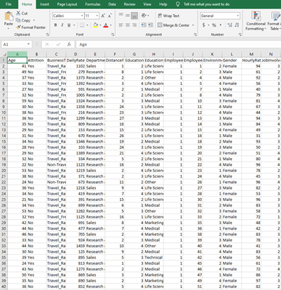
Data collection
Raw data:
35 variables
1470 observations

Slide 9

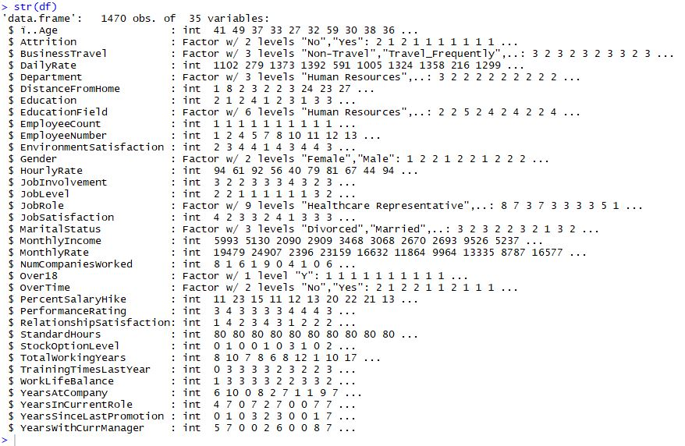
High-level data structure
Notes:
Used R to get a quick high level view of the data structure (e.g. variables, data types)

Slide 10
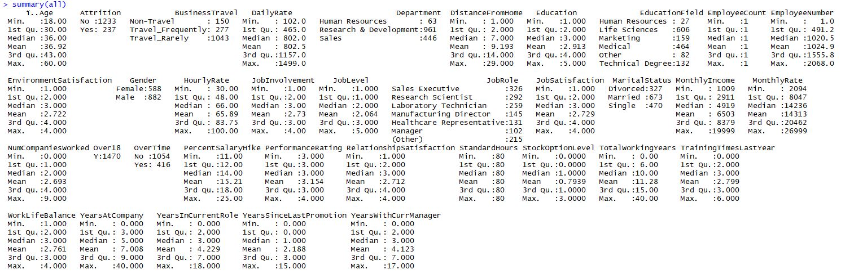
High-level examination of each variable
Attrition rate = 16%
Notes:
Also did a high level examination of each variable, which informs us what are the value counts under each variable, min/max values etc
Able to tell that attrition rate of SingVac is 16%, which is higher than optimal (around 10%)
There was also something peculiar about Performance Rating - although SingVac used a scale of 1 'Low'; 2 'Good'; 3 'Excellent'; 4 'Outstanding', they only had values of 3 and 4 (i.e. managers are not using the full rating scale, and organsiation is not doing anything about it). More importantly for this project, it will have implications for data analysis in that it is unlikely to come out as a significant predictor of attrition even if it is in reality
Lastly, we also noticed 3 variable that contained the same value within the variable so they can be removed from the analysis

Slide 11

Streamlining the dataset
Deleted fields | Reason
EmployeeCount | All values are ‘1’
Over18 | All values are ‘Yes’
StandardHours | All values are ‘80’
EmployeeNumber | Not meaningful to analyse
Notes:
Summary of variables removed from the dataset.
In addition to variables containing the same values as previously mentioned, we also removed employee number as it was not meaningful to analyse that

Slide 12
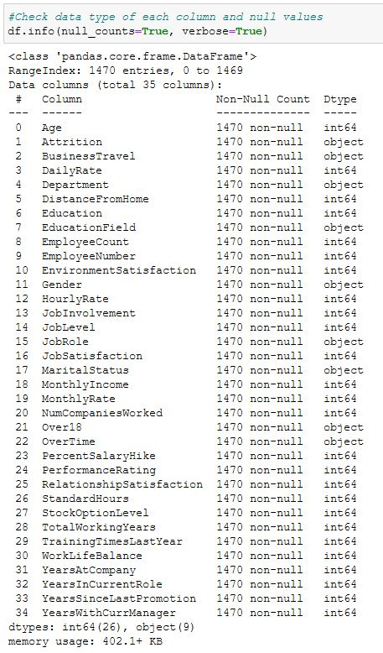
Checking for missing values
Notes:
Used Python to check for missing values - there were no null values in our data set

Slide 13
3. Data Representation and Transformation

Slide 14
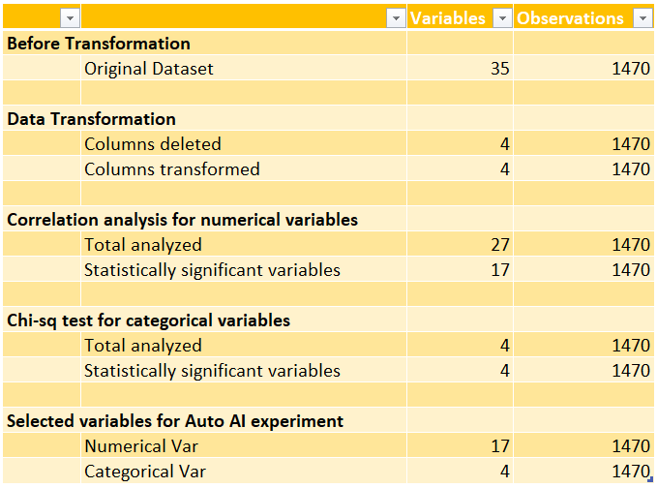




Dataset Overview

Slide 15
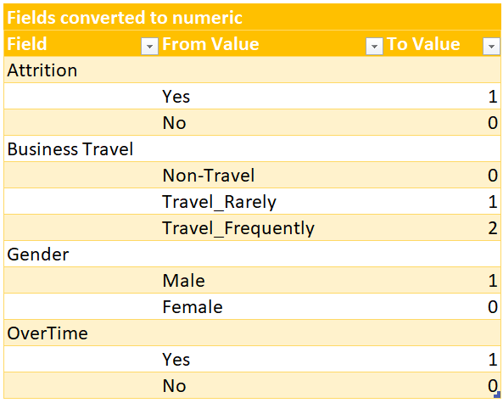
Data Representation and Transformation
Notes:
Descriptive Analytics- we transform the data into the desired form
eg. string to numerical because we want to perform correlation analysis
Made assumptions - all perm staff has stock option regardless of rank

Slide 16
Dataset Overview

Slide 17
4. Data Visualization and Presentation

Slide 18
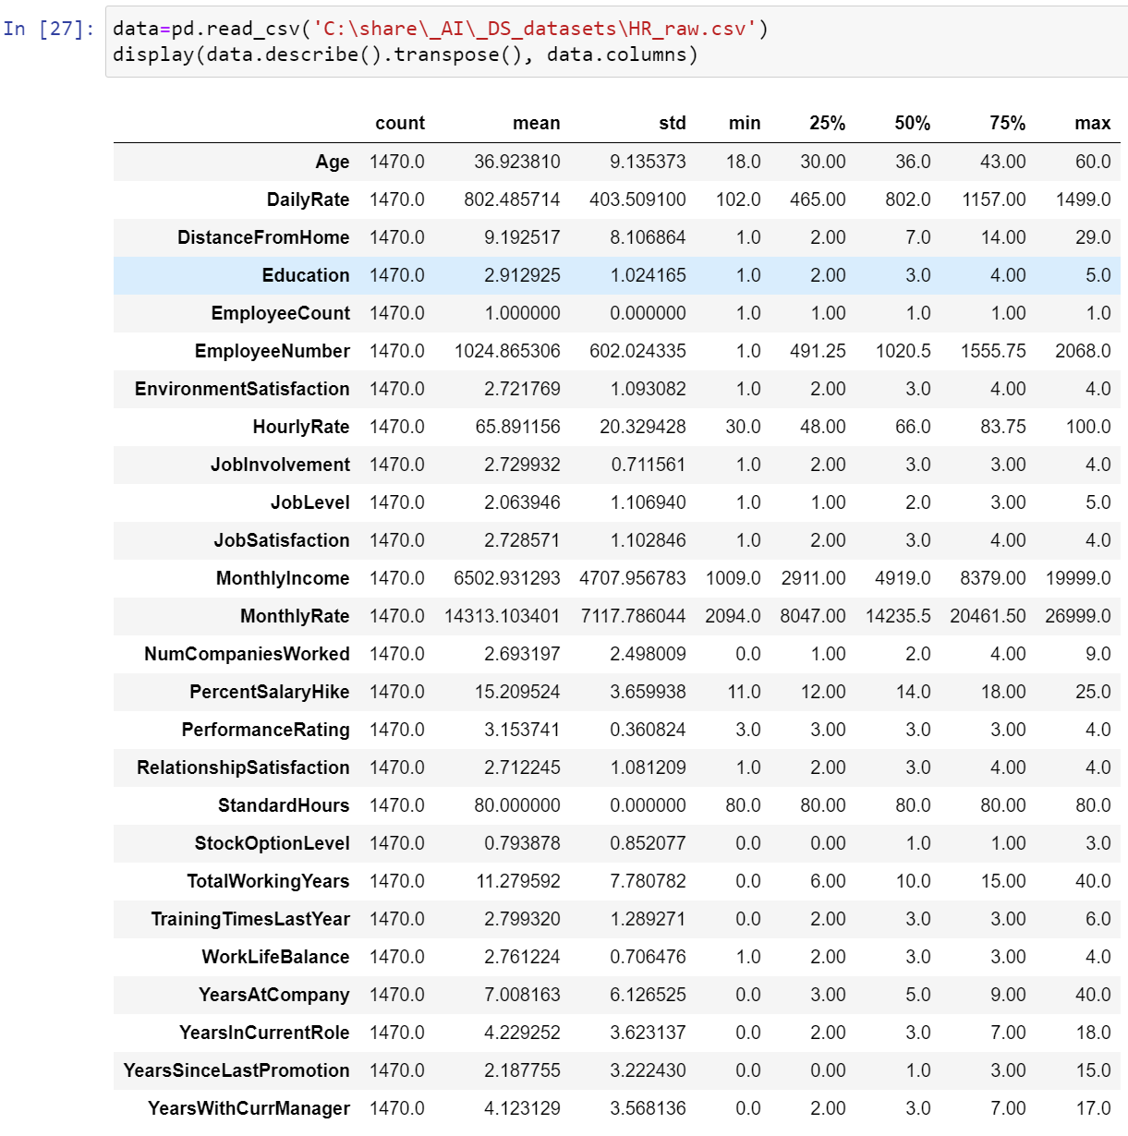

Some observations from descriptive
Statistics #1
Monthly income of employees range between $1009 to $19999, with an average of $6503
Employees stay between 0 to 40 years at the company, with an average of 7 years
Employees stay between 0 to 18 years in their current role, with an average of 4.23 years
Employees went for 0 to 6 times of training in the past year, with an average of 2.8 times

Slide 19
Some observations from descriptive
Statistics #2
On average, the employees scored the factors between “medium” to “high” on the below factors:
Satisfaction with working environment (mean = 2.72)
Job involvement (mean = 2.73)
Job satisfaction (mean = 2.73)
Performance Rating (mean = 3.15)
Relationship satisfaction with manager (mean = 2.71)
Work-life balance (mean = 2.76)

Slide 20
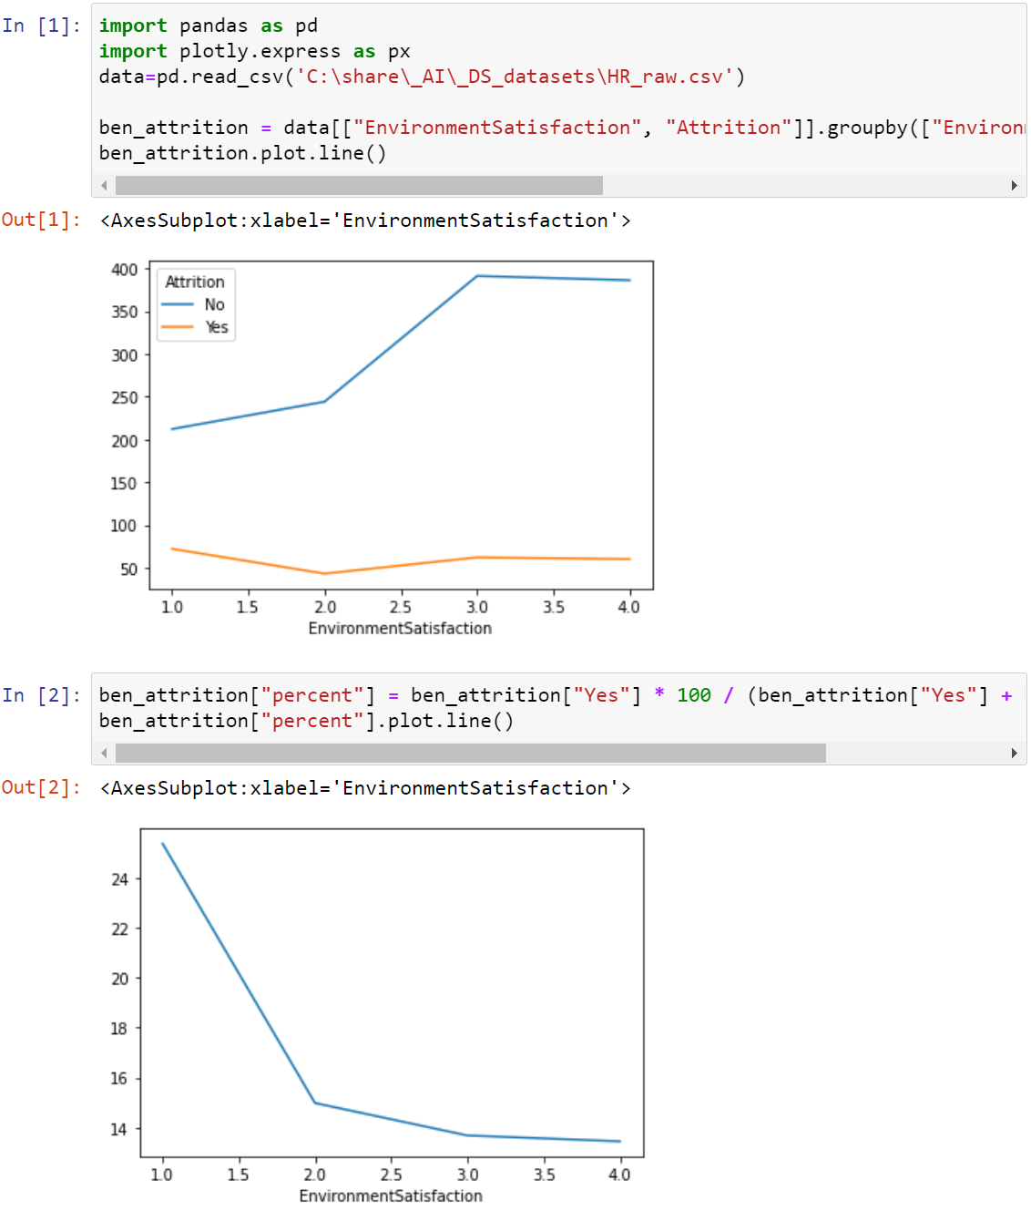
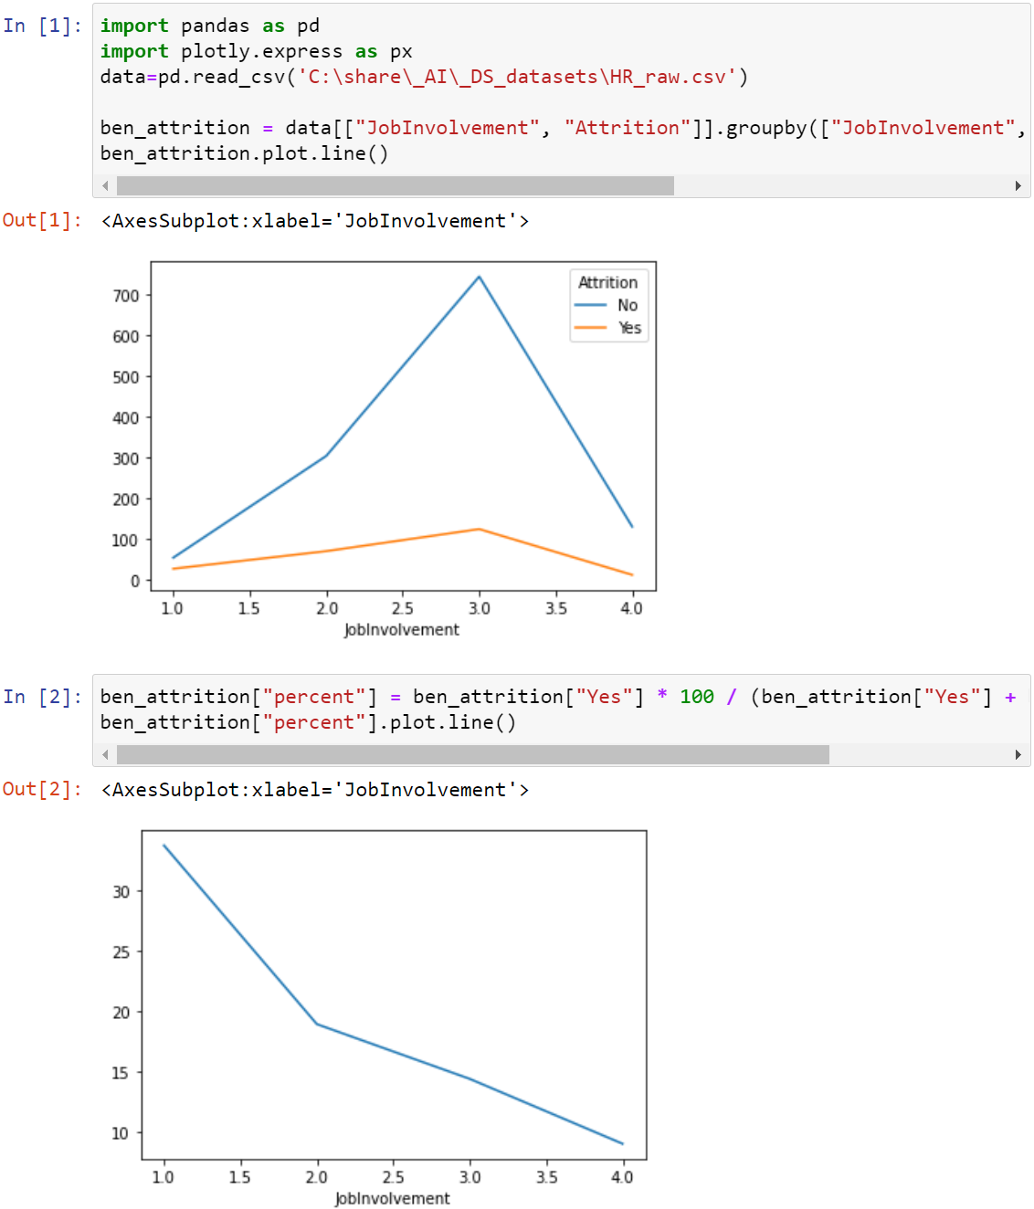
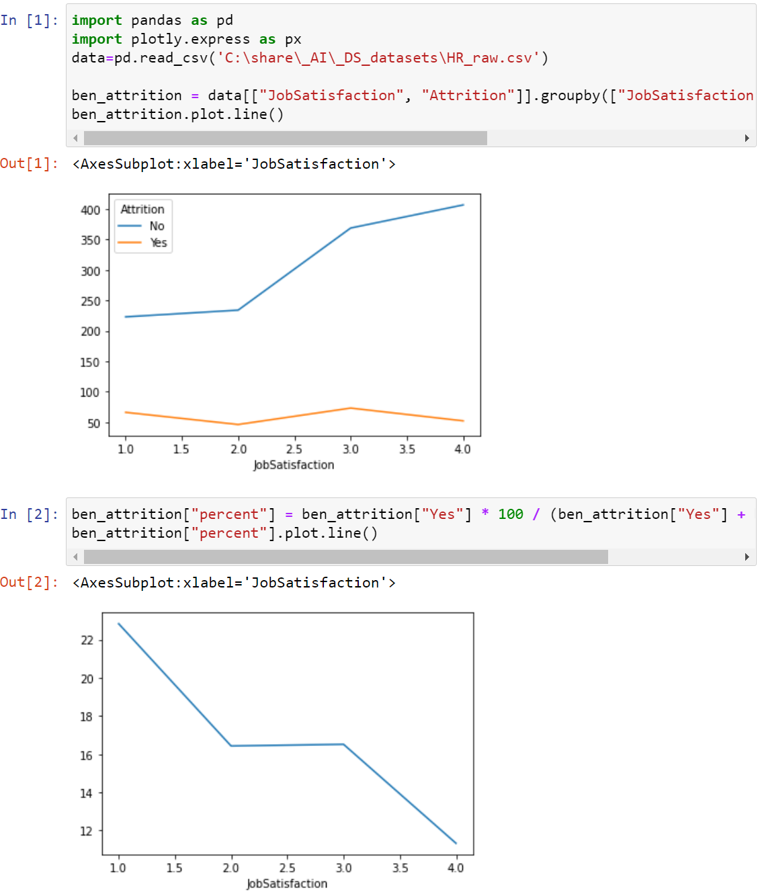
Attrition Observations #1

Slide 21
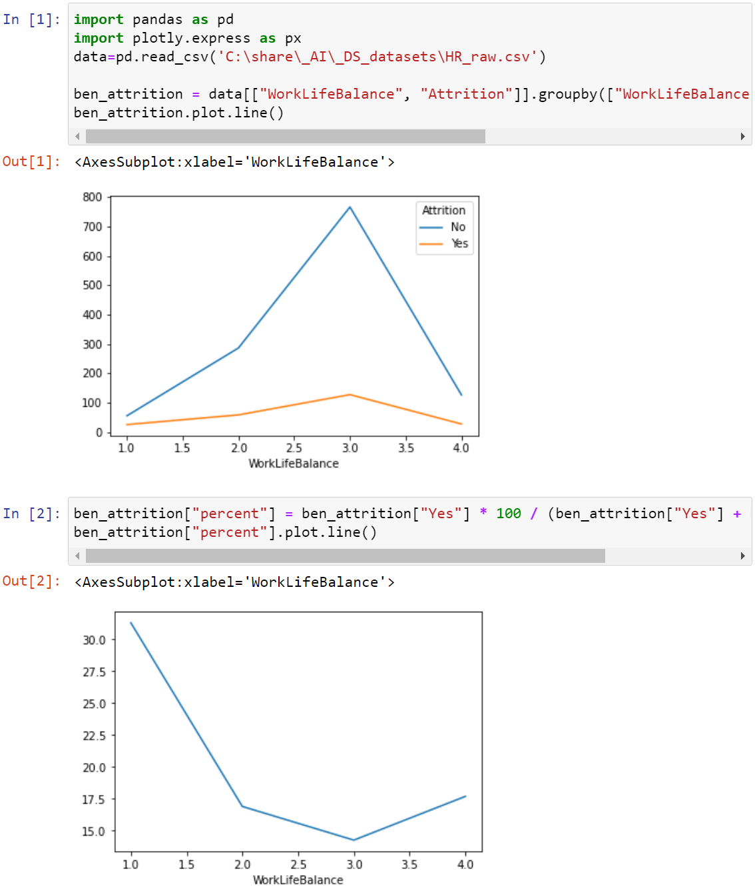
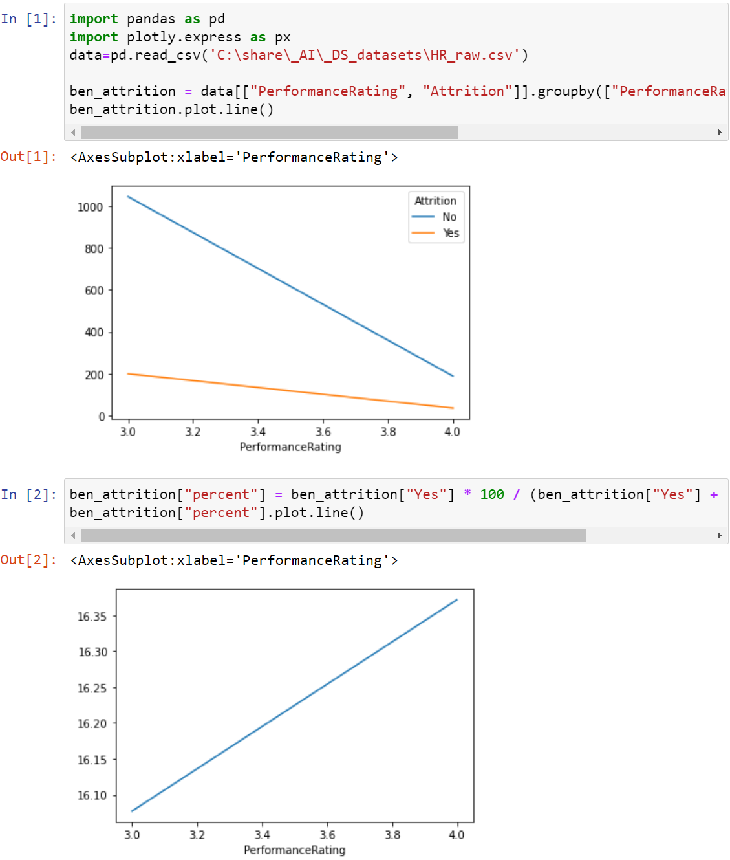
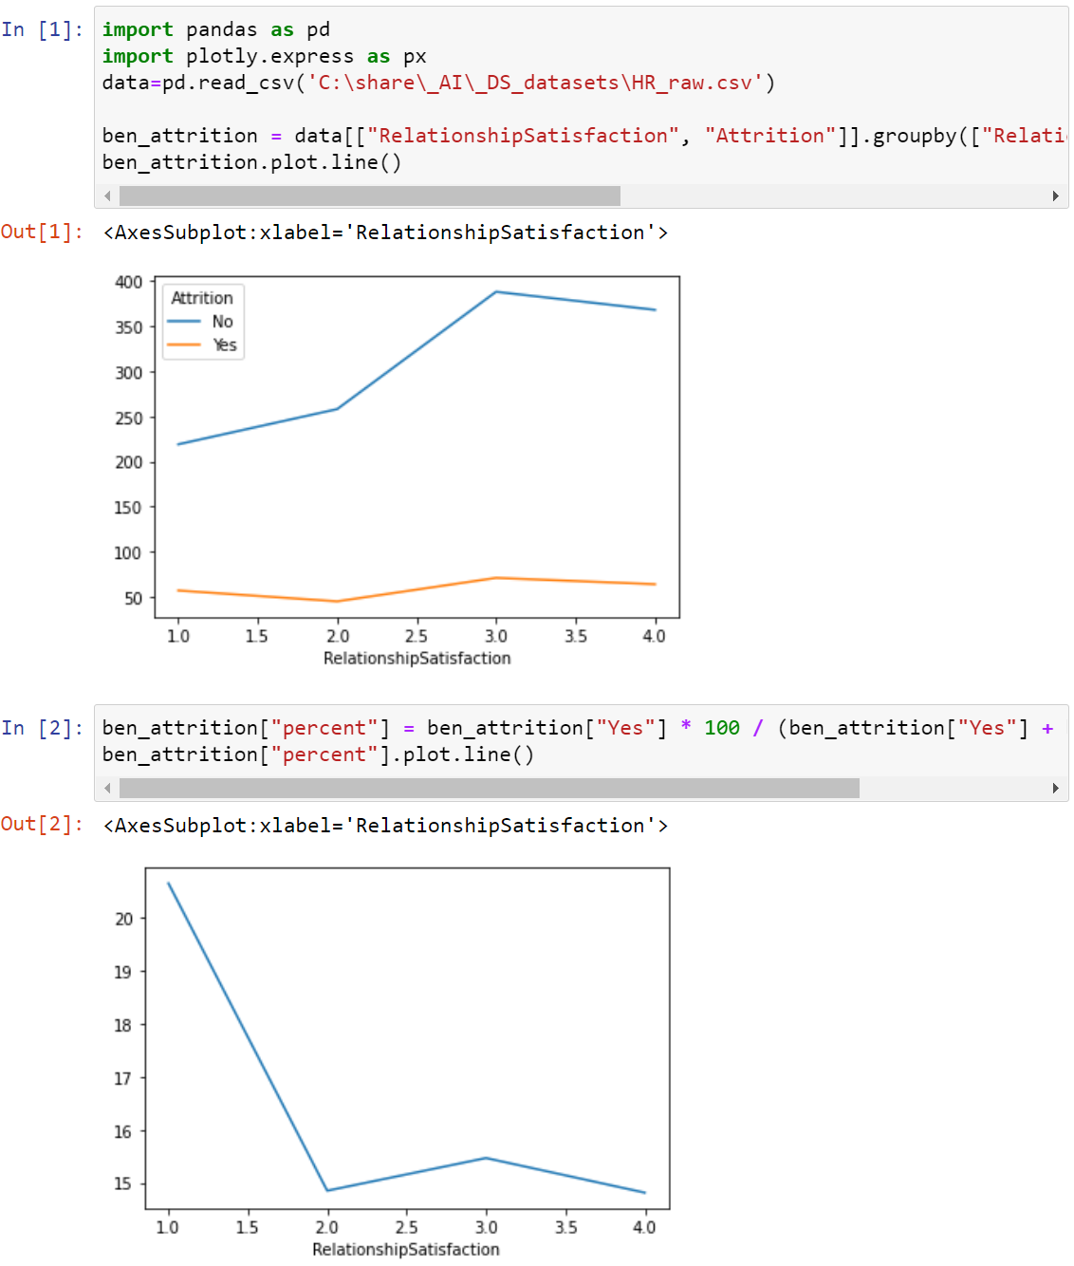
Attrition Observations #2
Notes:
Yes Count / (Yes Count +No Count)

Slide 22
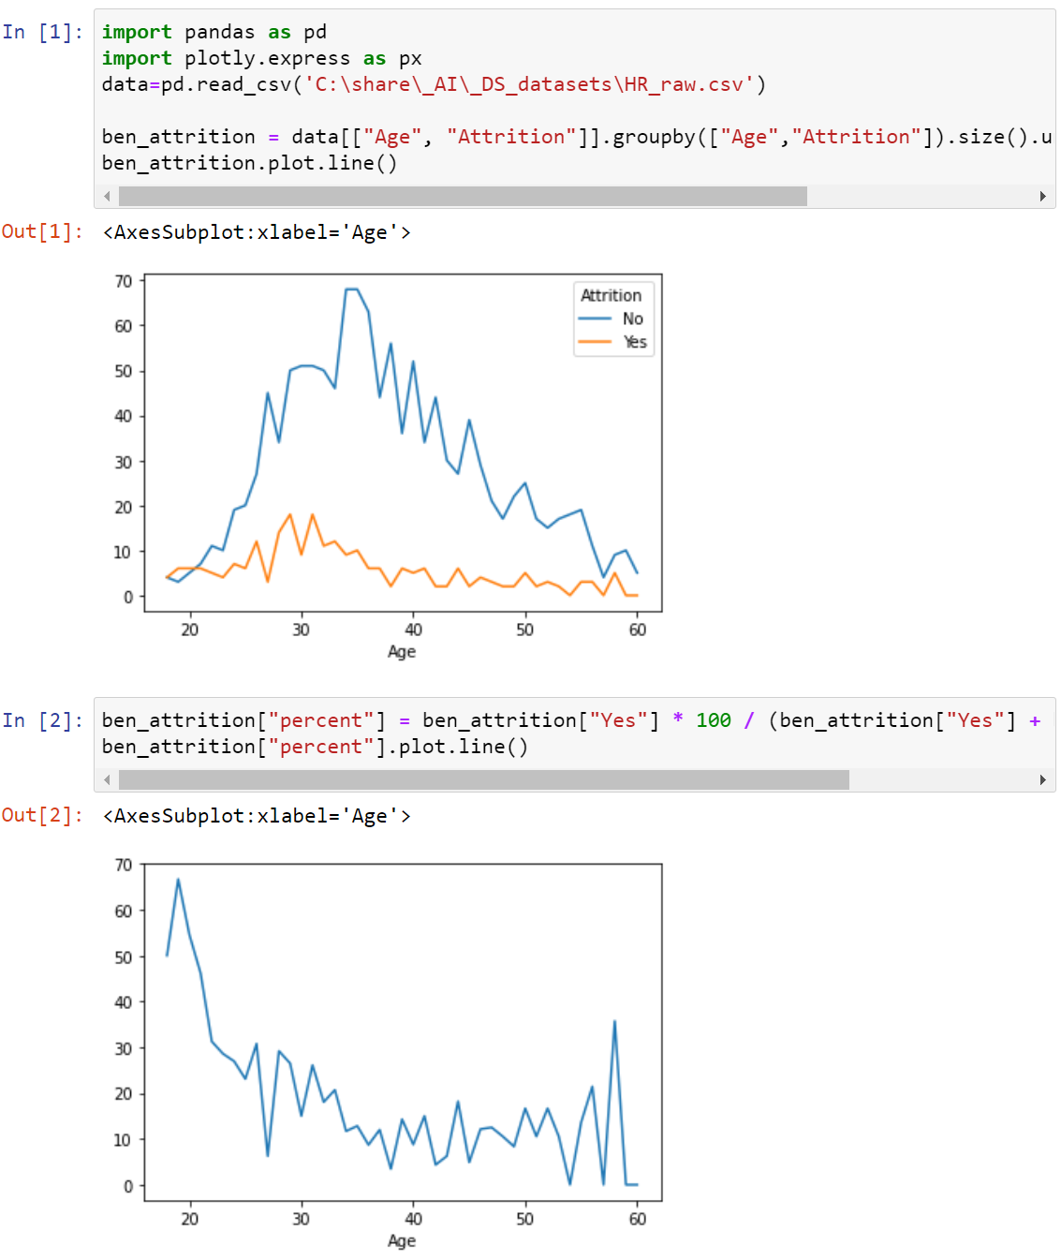
Attrition Observations #3
Observation - As seen in the chart, the attrition is maximum between the age groups 28-32. The attrition rate keeps on falling with increasing age, as people look after stability in their jobs at these point of times. Also at a very younger age, i.e. from 18-20, the chances of an employee leaving the organization is far more- since they are exploring at that point of time.

Slide 23
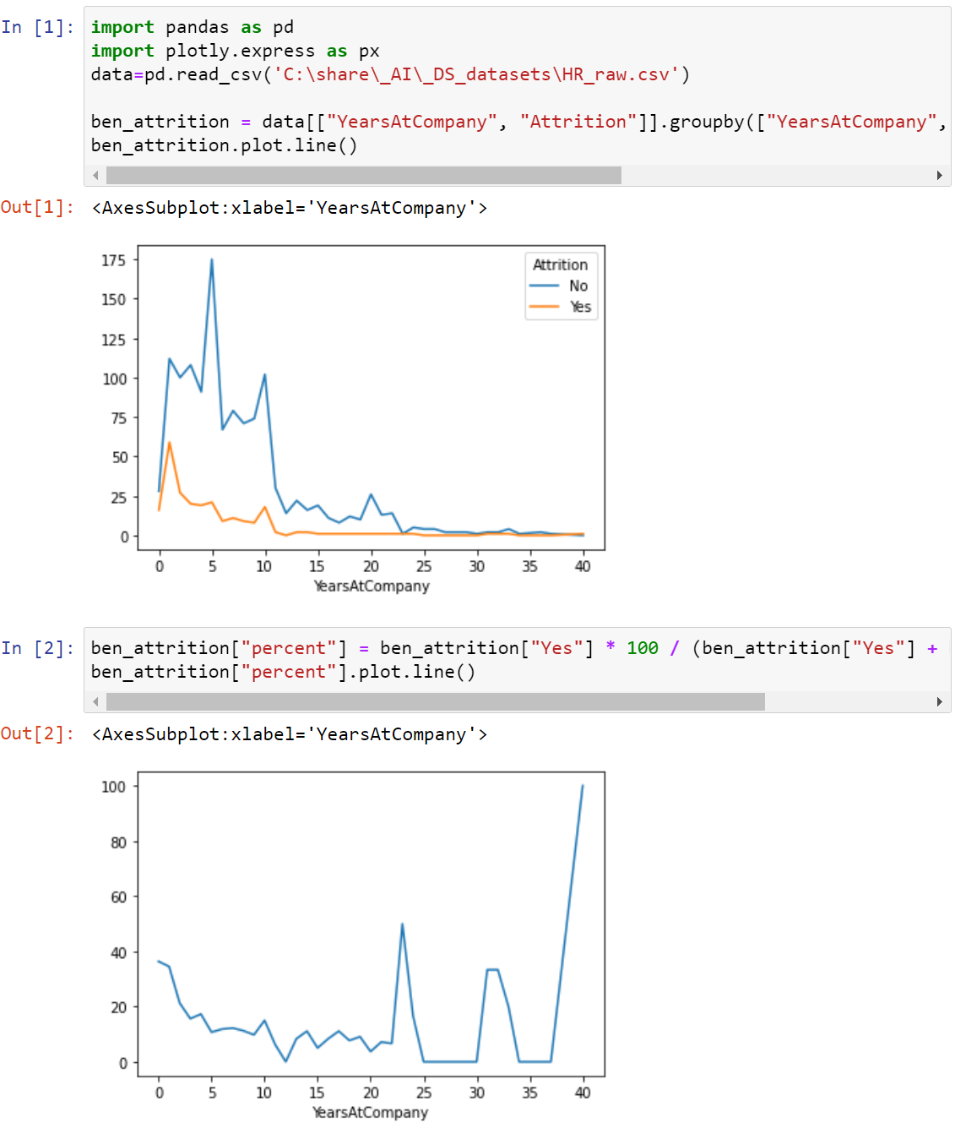
Attrition Observations #4
Observation - We have seen people are more prone to leave the organization in the starting years in the company. When people are in the same organisation for a long period of time, they tend to stay longer as they get used to the job role and organisation culture.

Slide 24
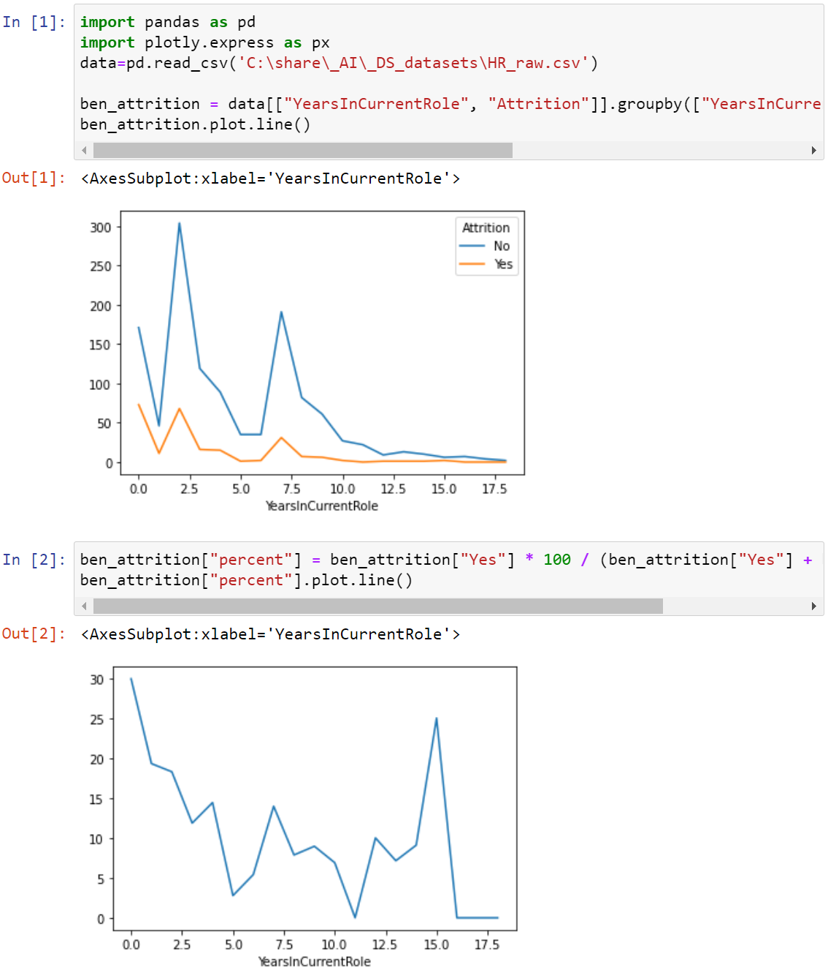
Attrition Observations #5
Observation - We have seen people are more prone to leave the organization in the starting years on their role or move up to better roles in company. When people are in the same role for a long period of time, they tend to stay longer for moving in an upward role.

Slide 25
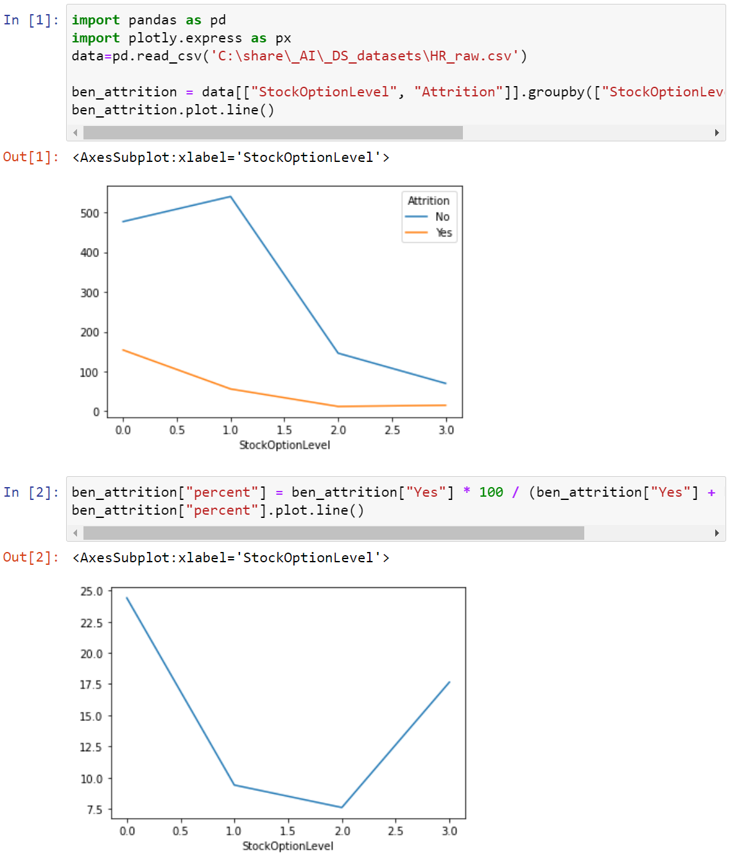
Attrition Observations #6
Observation - The tendency of employees to leave the organization is much more when the stock availing options are limited. Since the stocks constitute to a huge amount of money while staying for a few years, people do not want to lose that opportunity. People with very limited/no stock options have a freedom to leave the organization at will.

Slide 26
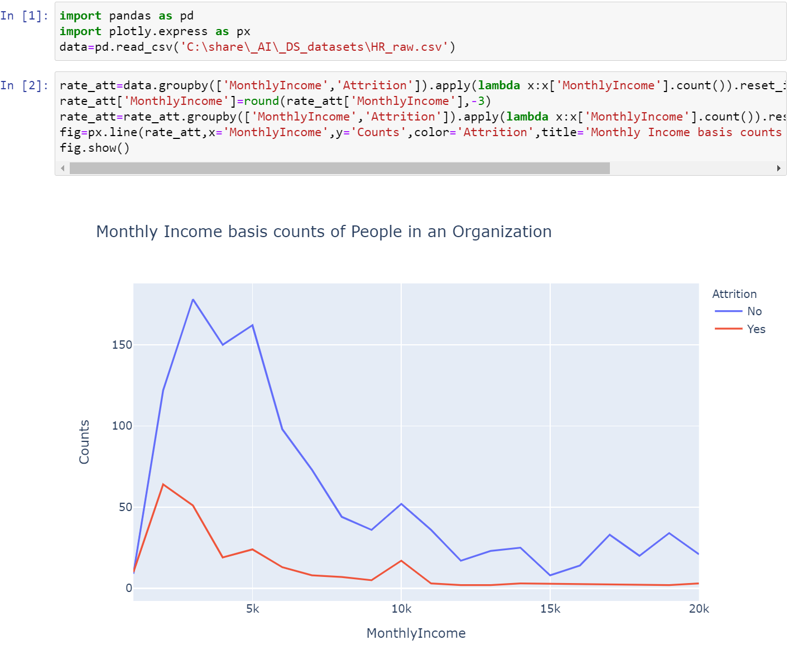
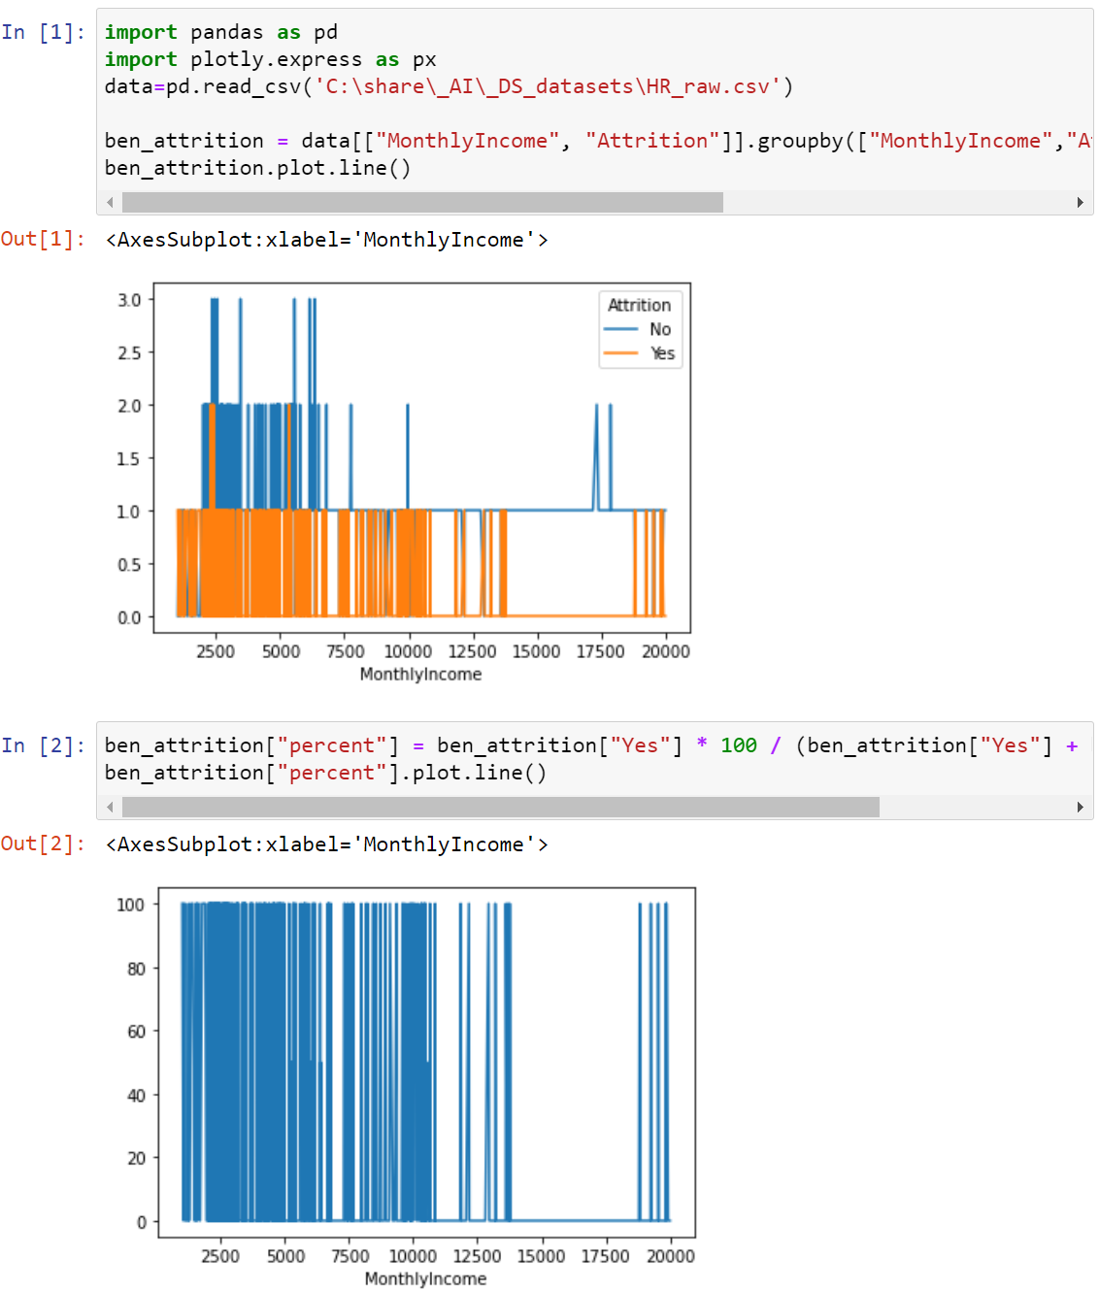
Attrition Observations #7
Observation - As seen in the chart, the attrition rate is evidently high at very low income levels- less than 5k monthly. This decreases further- but a minor spike is noticed around 10k- indicating the middle class livelihood. They tend to shift towards a better standard of living, and hence move to a different job. When the monthly income is pretty decent, the chances of an employee leaving the organization is low- as seen by the flat line

Slide 27
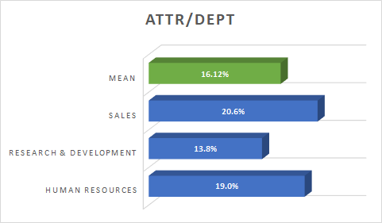
Visualization for Categorical Variables
Notes:
Understanding attrition rate specific to each department can enable deeper understanding of department-specific issues and more targeted interventions (this is the 2nd bucket - categorical statistics) surprising percentage attrition by department

Slide 28
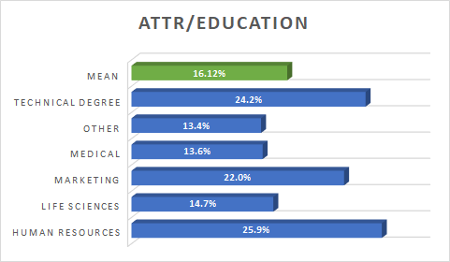
Visualization for Categorical Variables

Slide 29
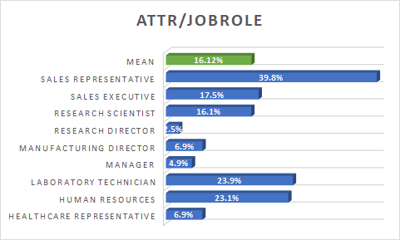
Visualization for Categorical Variables
Notes:
Understanding attrition rate specific to each job role can enable deeper understanding of job role specific issues and more targeted interventions

Slide 30
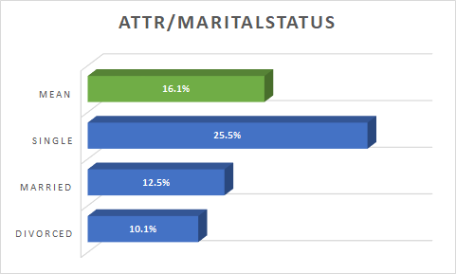
Visualization for Categorical Variables
Notes:
Understanding attrition rate specific to marital status may offer deeper insights e.g. when relating with work-life balance
Note: the green mean bar

Slide 31
Dataset Overview

Slide 32
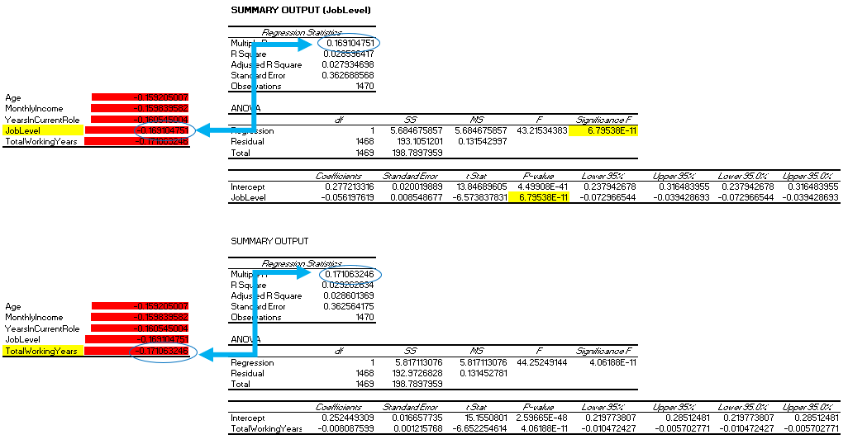
Correlation Analysis

Slide 33
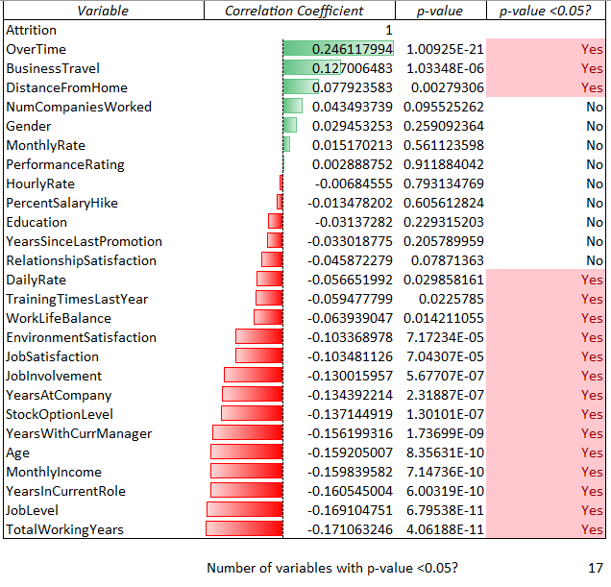
Correlation Analysis
Correlation results summary table for Numerical Variables
Notes:
This visualization is for data pattern and distribution so that we can use it for presentation to our target audience.
We visualize to meet our internal purposes but also for our situational context. (running p-value test proves that the correlation is significant)
We correlate the column we want to study back to Attrition column.
Presenting to the fictitious audience is SingVac C-level (CEO CFO HR etc and classmates/shareholders)

Slide 34
Dataset Overview

Slide 35
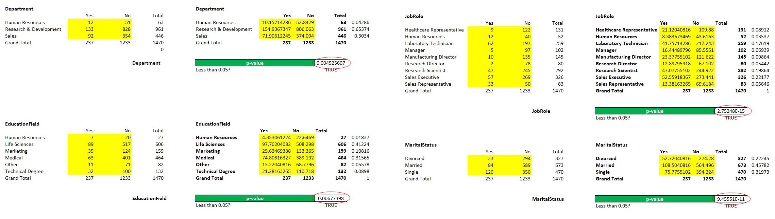
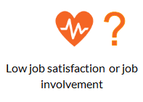
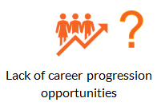
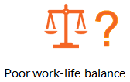
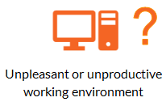
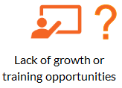
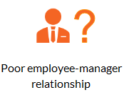
Chi-square tests (p-value)
Notes:
4 pivot tables created (to get a yes/no answer)

Slide 36
Chi-square tests
Chi-sq results summary table for categorical variables
Category | p-value | p < 0.05?
Department | 0.004525607 | TRUE
EducationField | 0.00677398 | TRUE
JobRole | 2.75248E-15 | TRUE
MaritalStatus | 9.45551E-11 | TRUE

Slide 37
Dataset Overview

Slide 38
5 & 6. Train and Validate Data Model

Slide 39
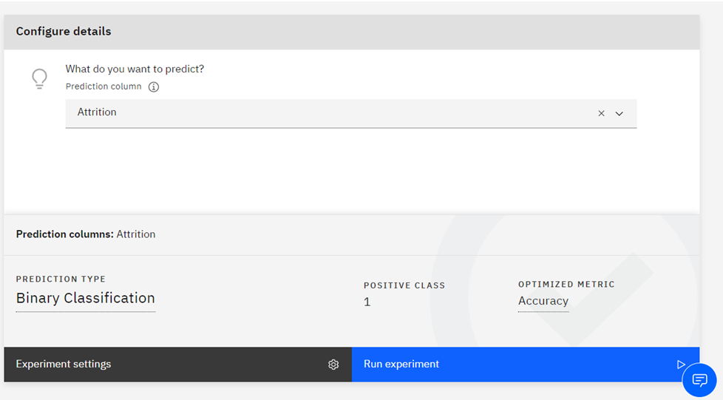
AutoAI Setup (load the refined data set)
Notes:
Using IBM Cloud AutoAI experiment
Loaded in the Numerical + Categorical refined data set

Slide 40
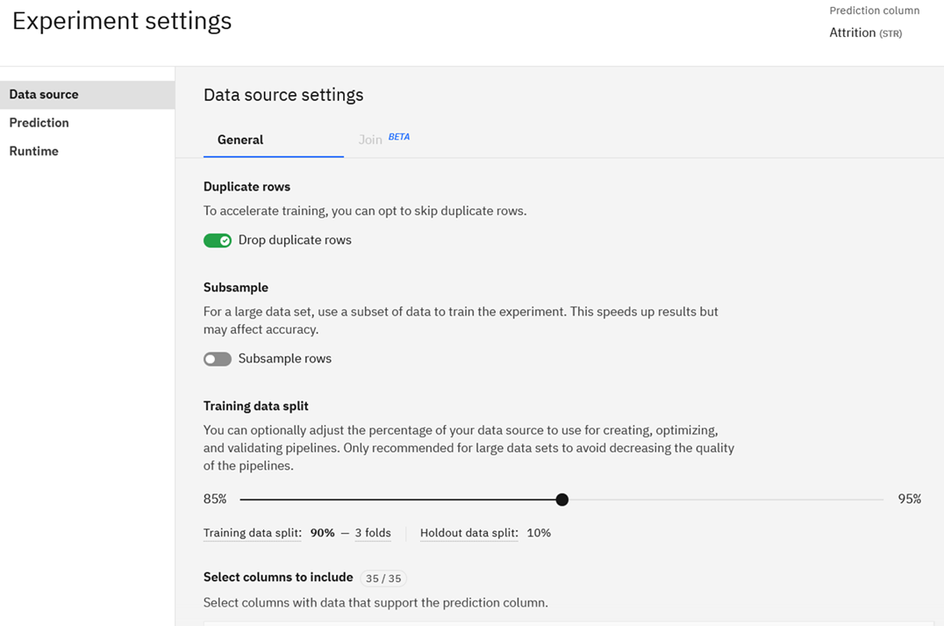
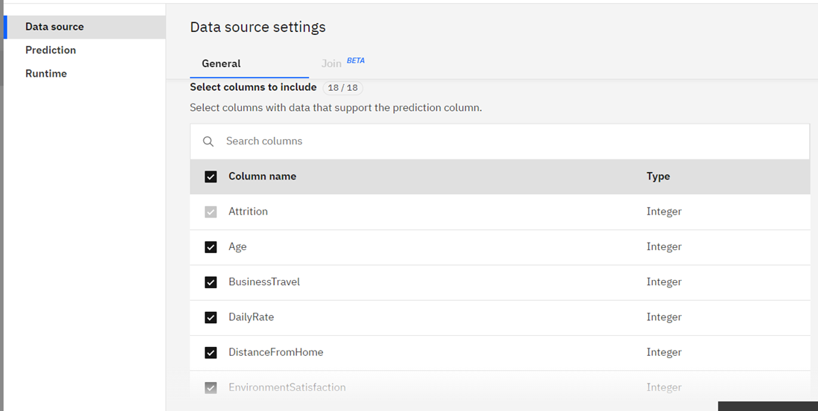
Data Source Settings
Select variables to include for AutoAI experiment
Training Data Split
Notes:
Have to show what columns / variables you are using for the AutoAI experiment

Slide 41
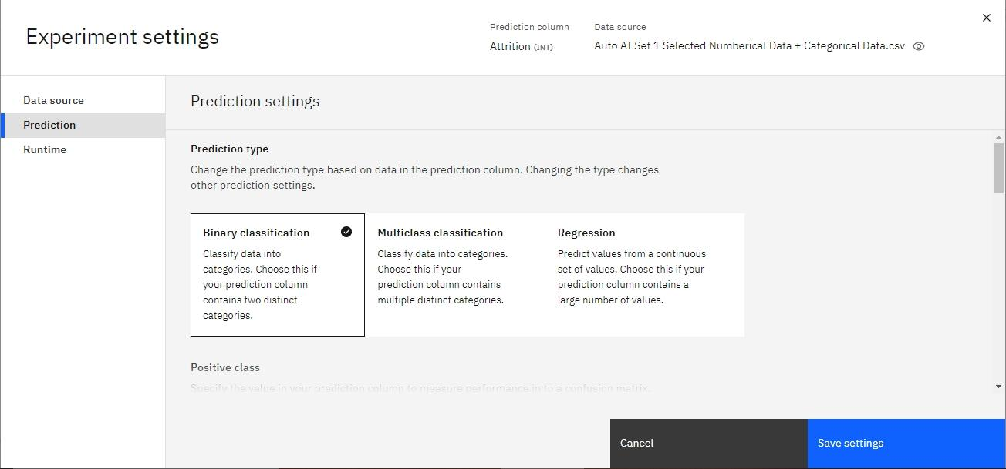
AutoAI Setup
Notes:
Going for 2 AutoAI experiments (8 models up to validation stage)

Slide 42
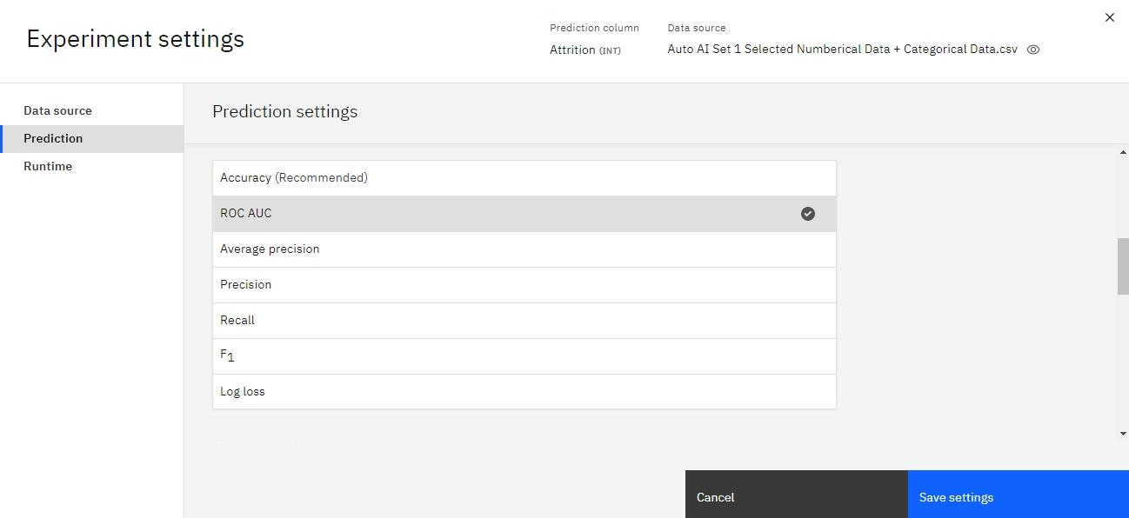
AutoAI Setup

Slide 43
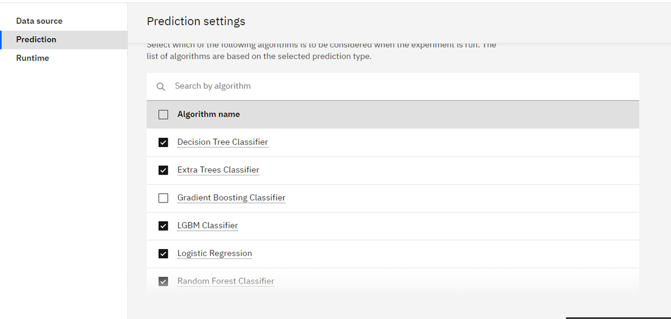
AutoAI Setup

Slide 44
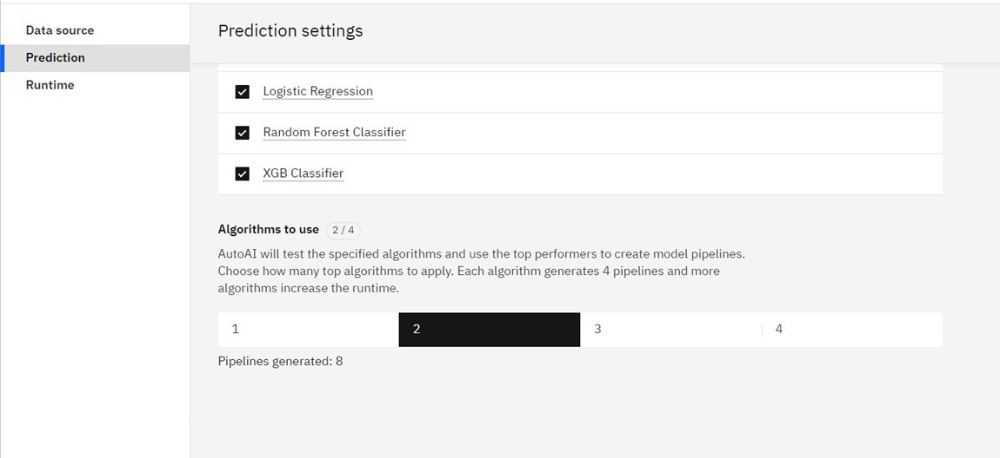
AutoAI Setup

Slide 45
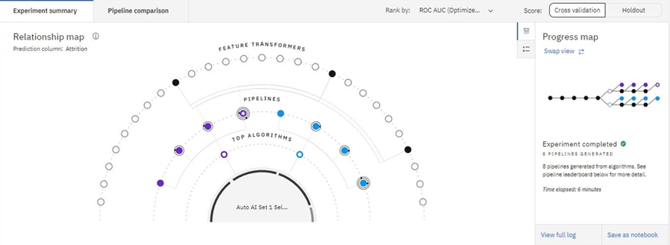
Generate AutoAI Experiment
Notes:
2 branches 2 algorithms
8 models 8 pipelines

Slide 46
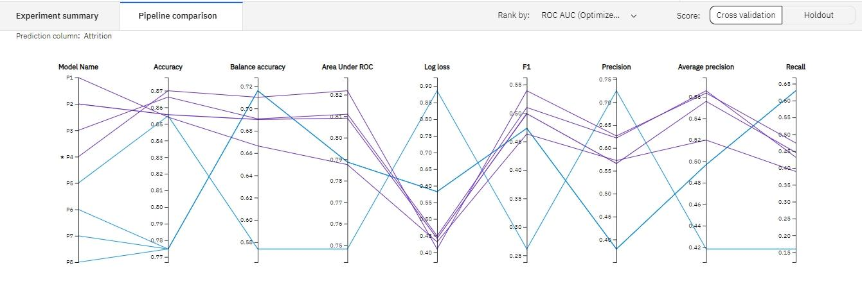
Pipeline Comparison
Notes:
Pipeline 4 has a good balance of accuracy and AUC ROC

Slide 47
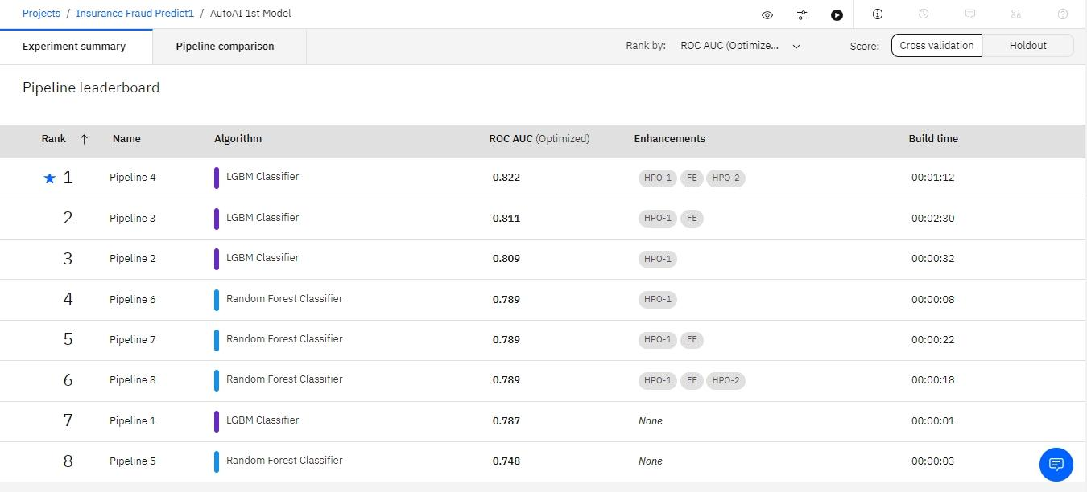
Pipeline Leaderboard
Notes:
XGB Classifier pipeline 7 has 0.828 ranking
HPO = hyperparameters tuning
FE = feature enhancements/engineering (ie. has new features- do we want these new features?))
“None” under Enhancements = no new features as factors and no hyperparameters tuning

Slide 48
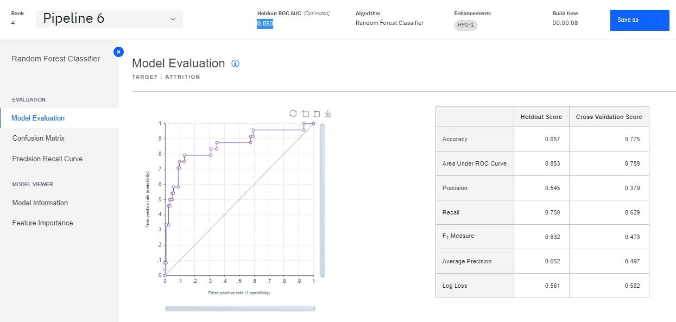
Model Selection
Notes:
Pipeline 6 Rank 4 Random Forest Classifier without FE was chosen.
Good trade-off between Accuracy and AUC ROC and no confusing new features.
the New Features created by the AutoAI eg. summation of age and monthly income didn’t make sense to our needs.
These new features are not useful in informing our recommendations (so we stick with Pipeline 6 as ROC is very close to Rank1 pipeline)

Slide 49
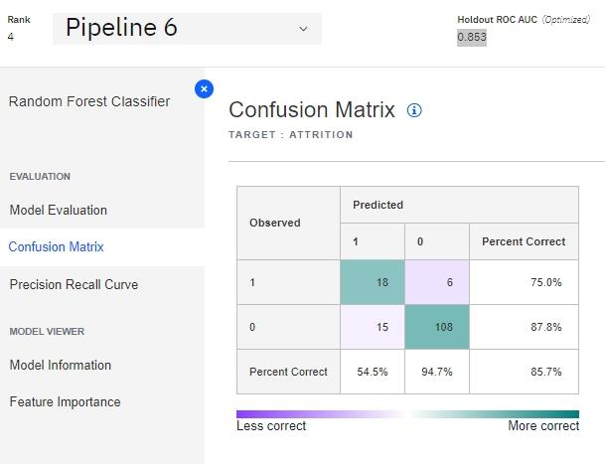
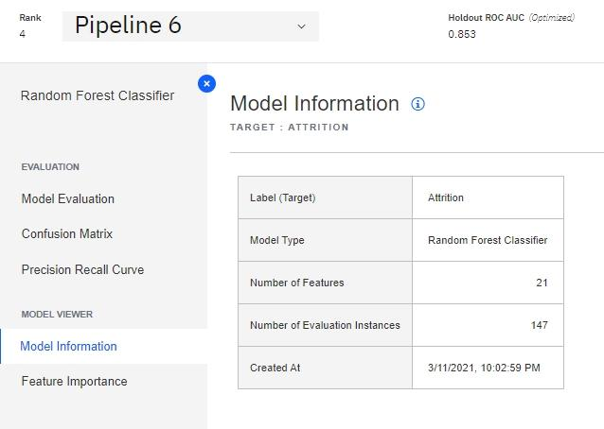
Confusion Matrix and Model Information
Notes:
10% data is test data contributed to this confusion matrix
false positives for SingVac does not seem costly

Slide 50
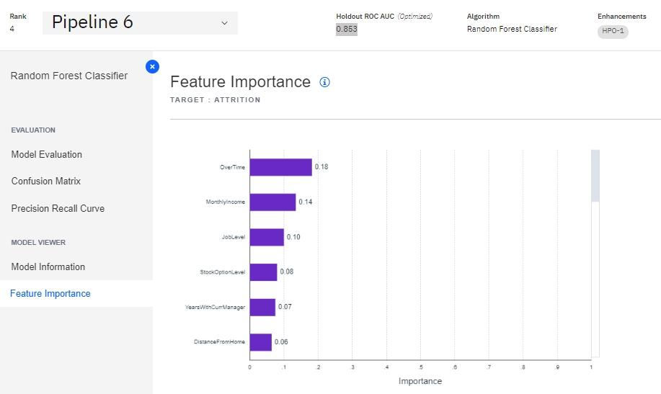
Feature Importance
Notes:
Feature importance is the initial predictive analytics seems to point to Job Level and Overtime for prescriptive analytics (for HR action)
Can we play around with the model? (using lesser variables give more difference)
One is running accuracy (right) and the other ROC (left) - How do we choose between ROC and Accuracy?
Which variables to throw away? We can go back to Correlation analysis to see which variables to keep or throw away

Slide 51
7. Deploy Data Model

Slide 52
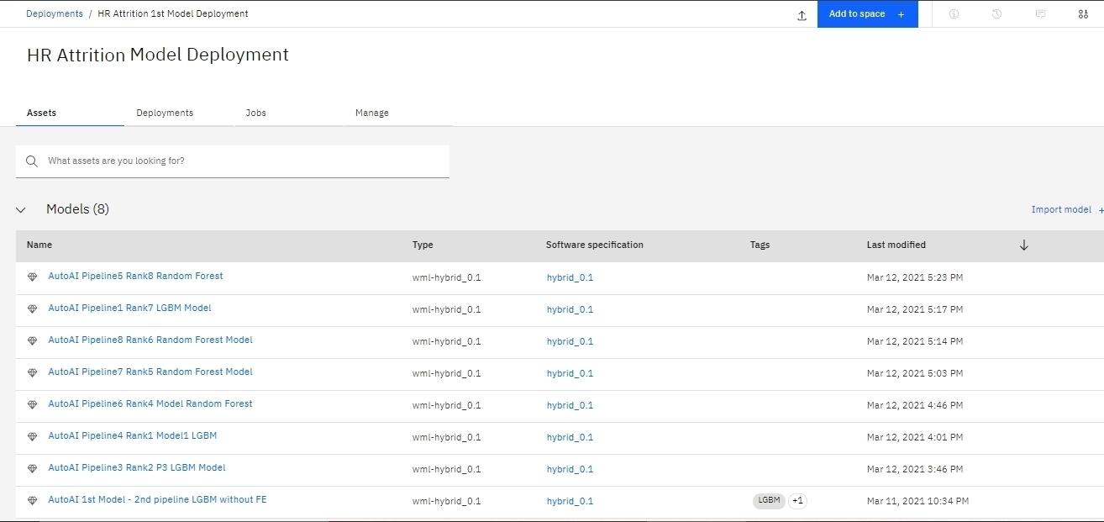
8 Models created from 8 pipelines
Notes:
https://cloud.ibm.com/
https://dataplatform.cloud.ibm.com/ml-runtime/deployments?context=cpdaas

Slide 53
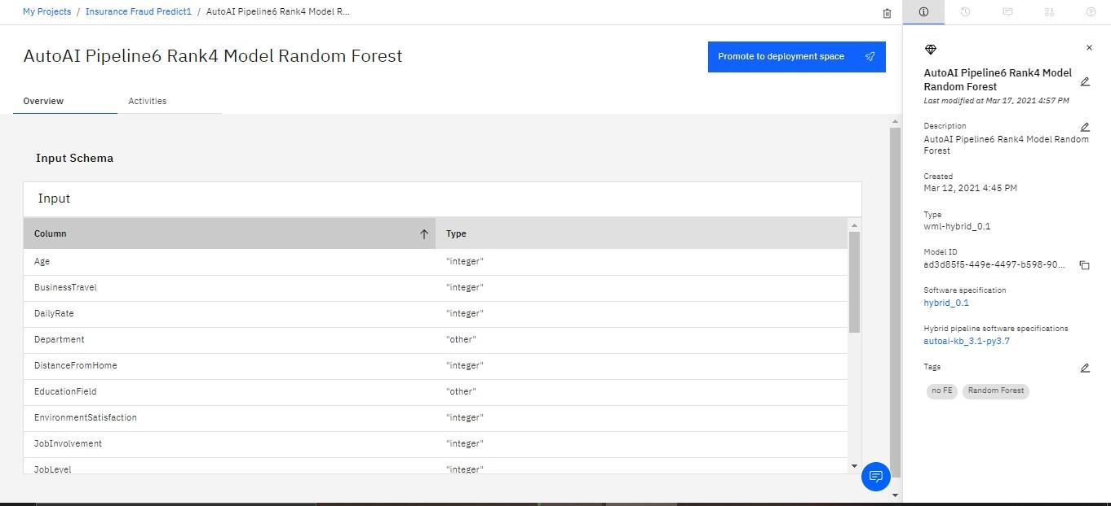
Pipeline 6 Rank 4 Promoted to Deployment Space

Slide 54
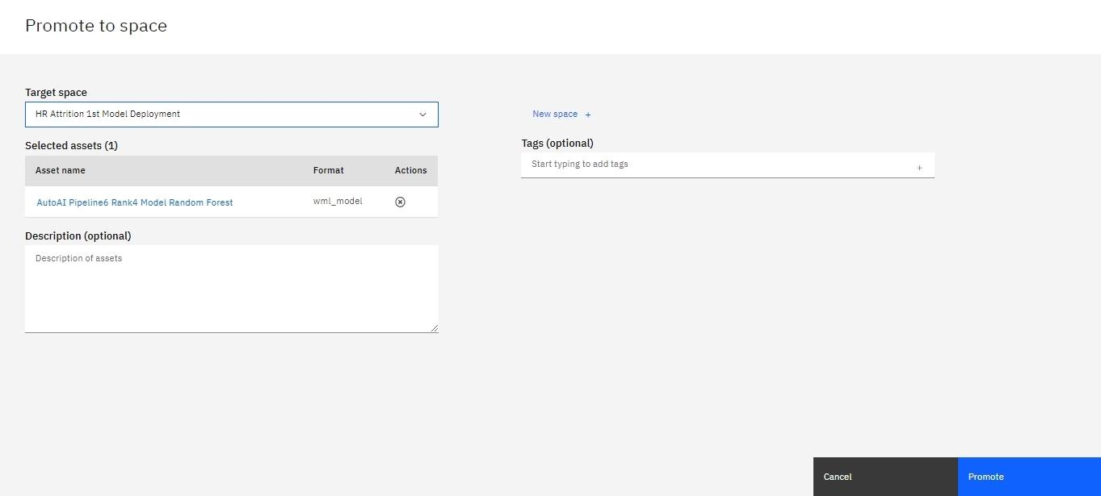
Promoted into a New Space

Slide 55

Other Deployments in HR Attrition Space

Slide 56

Chosen Rank 4 Model Deployed

Slide 57

Chose online for API flexibility

Slide 58

API key & Code snippets

Slide 59

Production Testing

Slide 60
8. Environment feedback
Notes:
Environment feedback is monitoring our model’s accuracy because models are not perfect and situations do change.
Playbacks to SingVac C-level management

Slide 61

SingVac future data for
Continuous Monitoring / Bookkeeping

Slide 62
Environment Feedback is needed to ascertain if the predictive model is still accurate as situations do change over time and if our recommendations are working in SingVac.
We have to get SingVac C-level permission to use their latest survey data in order to enter into our model to see its latest accuracy.
Hence, we prefer real-time playback to see how things are progressing.
If the accuracy decreases then a new AutoAI experiment may need to be done and a new model deployed.
Please note that this will be a new AutoAI experiment of a different model with its own subsequent deployment and test.
Monitoring or Changing the current model

Slide 63
Recommendations for SingVac

Slide 64

Employee-specific interventions
SingVac could use this machine learning model to identify employees at high risk of leaving
Managers of these employees could then be alerted in a timely manner so that they can intervene in time

Slide 65

Group-specific interventions using top factors correlated with Attrition
Notes:
In addition to employee-specific interventions, we also wanted to go further to make some group-specific recommendations drawing from the most important features that emerged from our ML model as well as our correlation analyses done earlier - we find that there is a huge overlap in terms of most important factors
For the purpose of this presentation, we will use the top 5 most important factors to make our recommendations for SingVac

Slide 66

Recommendation 1: Minimise the need to work Overtime
Observed significantly higher risk of attrition for employees who work overtime
SingVac could look into ways to increase work productivity (e.g. automating certain work processes) especially for workers who often need to work overtime

Slide 67


Recommendation 2: Review selection and onboarding processes for new hires
Attrition rate for employees with <=1yr in current role is very high
  Deeper analysis comparing with attrition rate by years at company reveal that it is the new hires who are staying a year or less (vs those who have been recently promoted)
SingVac should look into improving its selection and onboarding processes for new hires (e.g. buddy system), and also examine other possibly systemic issues (e.g. poor KM, etc)
Notes:
Important to select employees with good job and cultural fit as well as ensure good onboarding of new employees
Observation from data
SingVac should look into improving its selection (ensure job and cultural fit)
Quality of onboarding is important - studies have shown that organisations with good onboarding process greatly improve time to productivity, and minimize risk of employees leaving within first year (in one study, about one-third of the new hires who had quit said they'd had barely any onboarding). So perhaps SingVac could look into options such as putting in place a buddy system for new hires
SingVac HR should also try to identify other possible systemic issues such as poor KM that may make it frustrating and tough for new hires to get up to speed

Slide 68

Recommendation 3: Pay more attention to “fresh graduate” employees
Risk of attrition is relatively high especially for employees who only have <=1 year of working experience (i.e. more than 50% chance of them leaving)
SingVac could review whether it’s starting pay for fresh graduate hires are market competitive
Managers could try to be more sensitive to the needs of this group of employees (who have just entered the workforce)
Notes:
There is also a specific group of employees which SingVac needs to pay particular attention to - the fresh graduate employees - as the data shows that they have a 50% chance of leaving within the first year.
This group probably contributed a lot to the previously mentioned finding that there was a high attrition rate within the first year in current role and within 1 year at the company
For example, SingVac could study whether its starting pay for fresh grad hires are market competitive, and also importantly train its managers to be more sensitive to the needs of this group (e.g. may need more coaching and guidance; also good for them to be aware that millennials may have different needs - e.g. place larger emphasis on growth/learning, career progression opportunities, work-life balance)

Slide 69

Recommendation 4: Look into factors negatively affecting employees at Job Level 1
A large proportion of attrition are for jobs at level 1
Worthwhile to examine factors that could possibly be negatively affecting this group (e.g. are administrative processes too manual?)
Notes:
Our fourth recommendation targets employees at Job Level 1, as we observed that a relatively much higher portion of employees at this job level had left the organisation in the past year
It would be worthwhile for SingVac look into factors that could possibly be negatively affecting this group

Slide 70

Recommendation 5: Ensure salary is market competitive particularly for employees earning <$5K
There is a higher likelihood of attrition for employees whose monthly income is <=$5K to leave
SingVac should seek to ensure that the salary for this group of employees are market-competitive
Also good for managers to be aware of this trend so that they can be more conscious in meeting the needs of this group of employees through other means
Notes:
Lastly, we also recommend for SingVac to review whether its compensation package for employees are market competitive, especially for employees earning below $5K, as the data is showing that employees earning $5K and below are showing a much higher tendency to leave the company
This is understandable as people tend to put a lot of effort to get their salaries up to an amount that is “comfortable” for a decent standard of living
Hence, it is important for SingVac to pay attention to this group
It is also good for managers to be aware of this trend so they can be more conscious in meeting the needs of this group of employees through other means right from the start that may not necessarily mean more cost for the company (e.g. some employees may be looking out more for growth opportunities rather than higher salary per se, and managers are in best position to decide how best to meet their employees’ needs)

Slide 71

We welcome your questions and feedback!

